Slide 1
Arduino – LED Blinker without delay()
Adrian Gould
ICT50220 - Diploma of Information Technology
Cluster Intermediate IOT
Notes:
Based on:
Arduino Millis Tutorial - Millis() the Delay Killer - using millis() for timing instead of Delay (electronicshub.org)
Pushbutton and Flashing LED with mills() tutorial (baldengineer.com)
Alternate Blinking LEDs with millis() | Let's Start Coding | Coding for Kids (letsstartcoding.com)

Slide 2
Create TinkerCAD circuit
Open TinkerCAD
Create the circuit as described below:
Connect the ground rails together (black wire)
Connect the positive rails together (red wire)
Add one LED to a small breadboard
Add one 500 Ohm resistor to the cathode of the LED
Connect the other side of the resistor to a ground rail

Slide 3
Create TinkerCAD circuit
… continued
Connect the anode of the LED to Pin 3 on the arduino
Add one pushbutton across the central channel
Connect one 1K Ohm resistor to bottom left of pushbutton
Connect the other end of the 1K resistor to the ground rail
Connect the bottom right of pushbutton to positive rail

Slide 4
Create TinkerCAD circuit
… continued
Connect the top left of pushbutton to pin 8 on the Arduino
Connect the positive rail to the 5V on the Arduino
Connect the negative rail to a ground on the Arduino

Slide 5
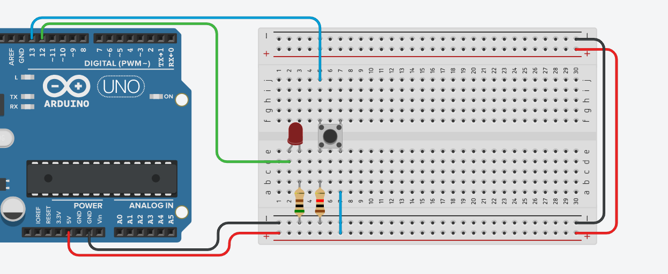
Create TinkerCAD circuit

Slide 6
Write the Code to Blink
Blink the LED every second for one second:
const int ledPin = 3;
void setup()
{
pinMode(ledPin, OUTPUT);
}
void loop()
{
digitalWrite(ledPin, HIGH);
delay(1000);
digitalWrite(ledPin, LOW);
delay(1000);
}

Slide 7
Blink LED when Pushbutton Down
Write the code to blink the LED when pushbutton pressed
#define SWITCH_PIN 8
#define LED_PIN 3
#define TIME_ON 1000
int switchState = 0;
void setup()
{
pinMode(LED_PIN, OUTPUT);
pinMode(SWITCH_PIN, INPUT);
}
void loop()
{
switchState = digitalRead(SWITCH_PIN);
if ( switchState == HIGH ) {
digitalWrite(LED_PIN, HIGH);
delay( TIME_ON );
digitalWrite(LED_PIN, LOW);
delay( TIME_ON );
}
}

Slide 8
What’s the Problem?
What happens when you briefly press the button?
What happened when you press the button two or three times in one second?
What’s the problem?

Slide 9
What no Delay?
How to remove Delay?
We will use
millis()
millis returns the number of milliseconds the code has been running
Time difference between calling ‘millis’ twice will help:
Difference = Current ms – Previous ms

Slide 10
What no Delay?
int period = 1000;
unsigned long time_now = 0;
void setup() {
Serial.begin(9600);
}
void loop() {
if(millis() > time_now + period)
{
time_now = millis();
Serial.print("Time: ");
Serial.print(time_now/1000);
Serial.print("s - ");
Serial.println("Hello");
}
//Run other code
}
Create a new TinkerCAD
Name: InterRiot-NoDelay
Add the code shown
Open the Serial Monitor at the bottom of the screen
Run the simulation
What happens?

Slide 11
Blinking no Delay!
Using the previous example
Let’s write our blink without using delay()

Slide 12
Blinking without delay()
const int ledPin = 3;
int ledState = LOW;
unsigned long previousMillis = 0;
const long interval = 1000;
void setup()
{
pinMode(ledPin, OUTPUT);
}

Slide 13
Blinking without delay()
void loop()
{
unsigned long currentMillis = millis();
if (currentMillis - previousMillis >= interval)
{
previousMillis = currentMillis;
if (ledState == LOW)
{
ledState = HIGH;
}

Slide 14
Blinking without delay()
(continued from previous slide)
else
{
ledState = LOW;
}
digitalWrite(ledPin, ledState);
}
}

Slide 15
Exercise
As with the “delay” version of blink…
Add a check for the button press
Blink LED for 1 second when pressed briefly
What happens when you press the button more than once quickly?

Slide 16
END
Session 2

